Slide 1

Aggregated Data Management in a Digital Portfolio
Edita Pronckute - S8 – User Interaction Graduation Internship

Slide 2



Contents
Introduction
Assignment
Outcome
Demo
Reflection

Slide 3
Introduction

Slide 4
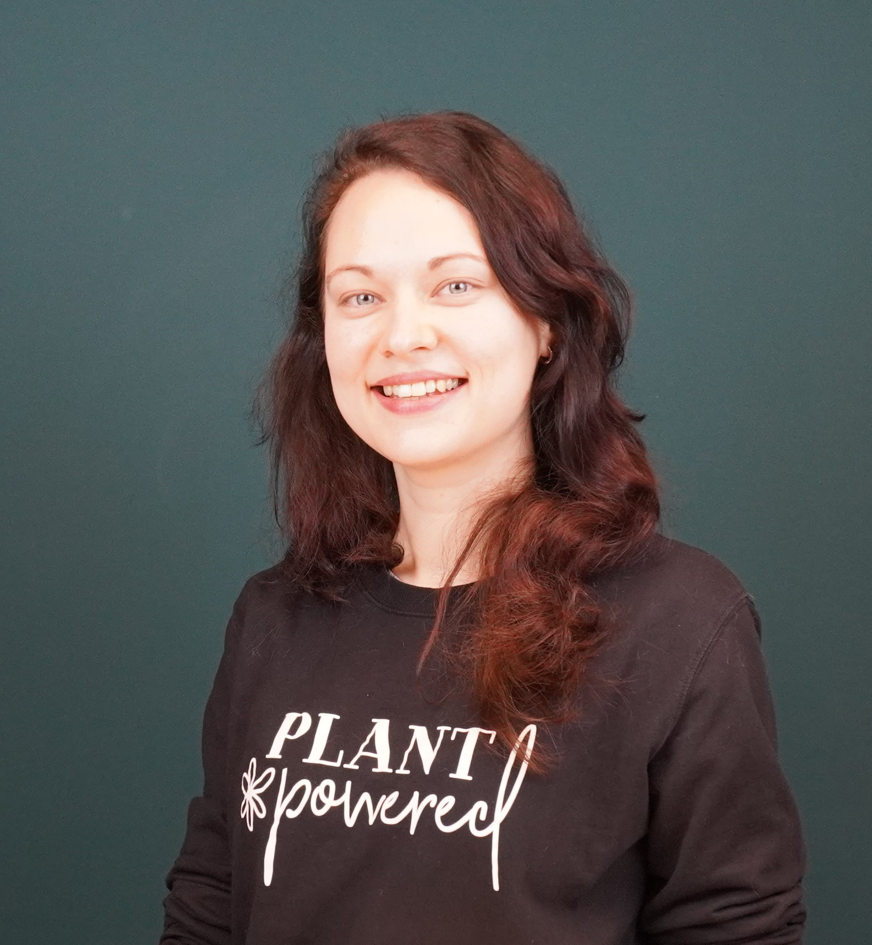



About me
Edita Pronckute
Graduation Internship
Fontys UAS student
ICT & Software Engineering
Vilnius University
MBA in Marketing & Global Business
Fontys UAS Medewerker
International Marketing

Slide 5

About Drieam
Fast growing EdTech scale-up
Colleagues with expertise in development, UX & consultancy
Focus on higher education and continuing education
Instructure Partner for 5+ years, working with Canvas as LMS

Slide 6






Slide 7
Assignment

Slide 8
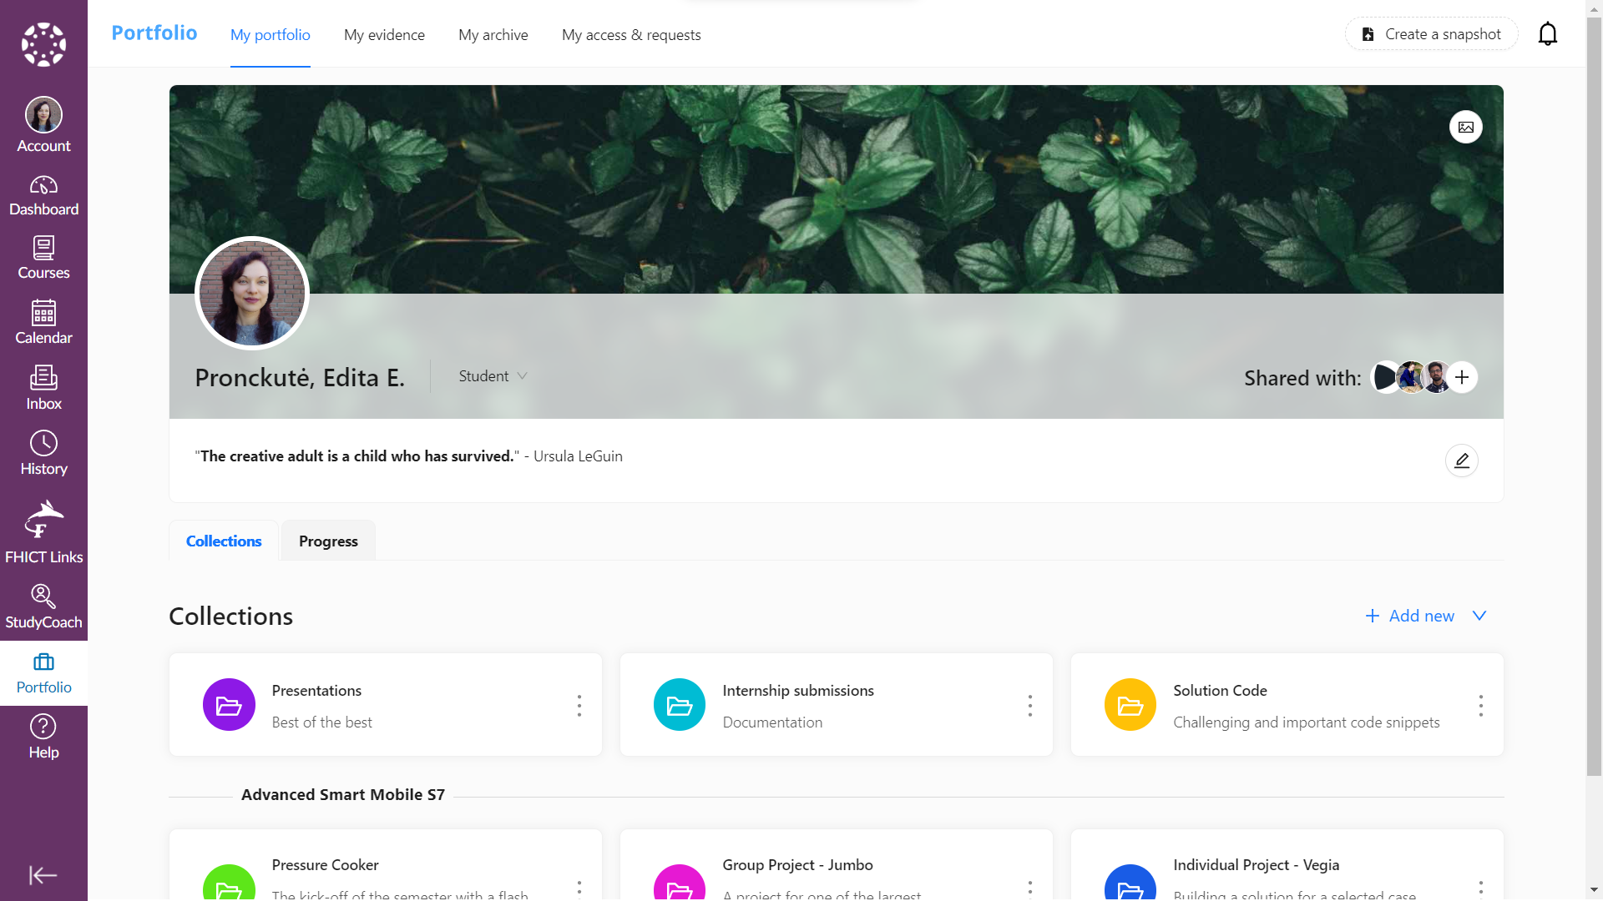

Slide 9
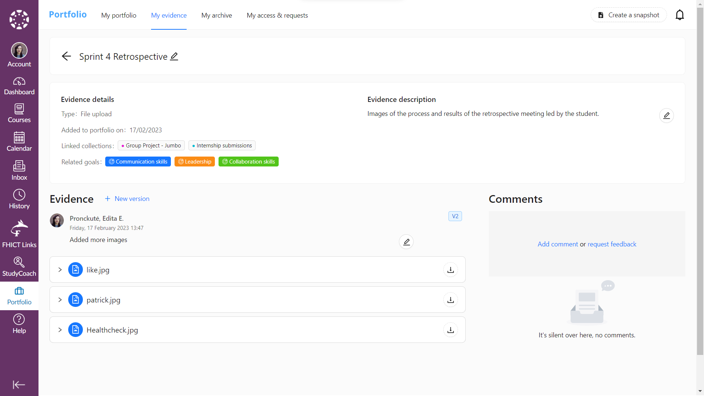

Slide 10
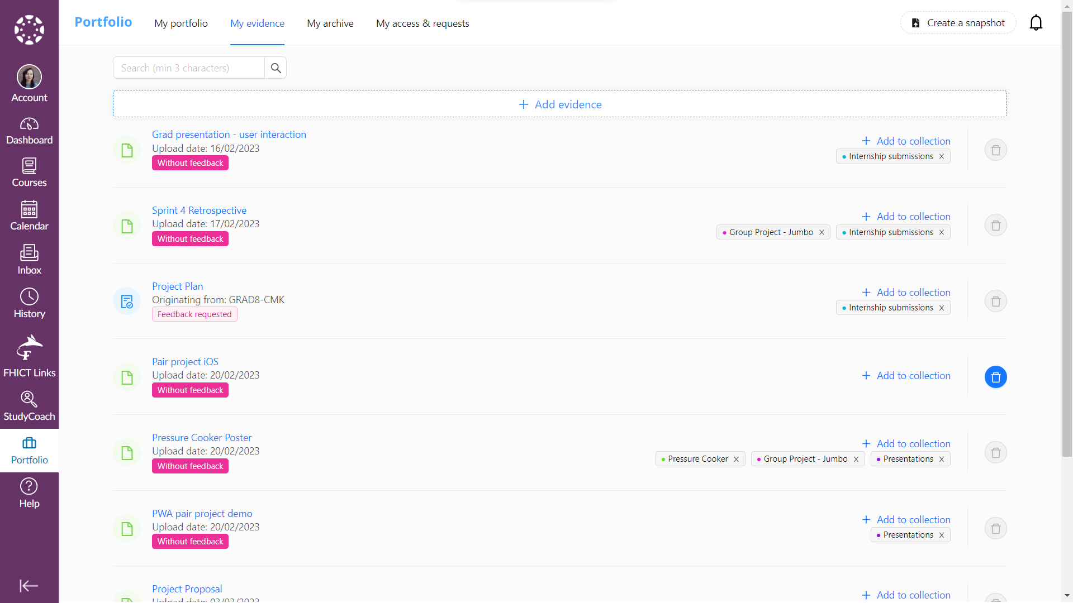
Notes:
Only visible to student
All these action can be done from main “My portfolio” view
Currently students do not use this page

Slide 11
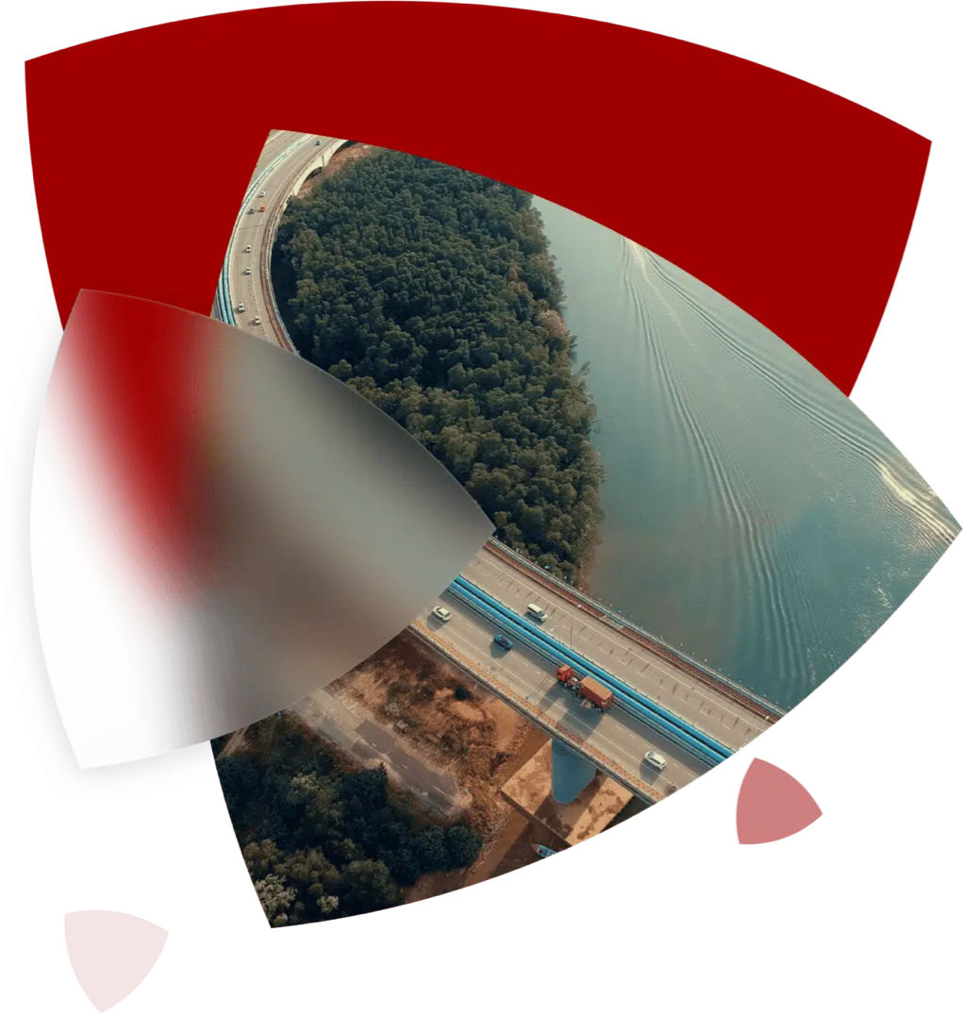
Opportunities
Usefulness
Functionality
Meaning
Look & feel
Notes:
Goal was to take these opportunities and improve the page

Slide 12
Outcome

Slide 13
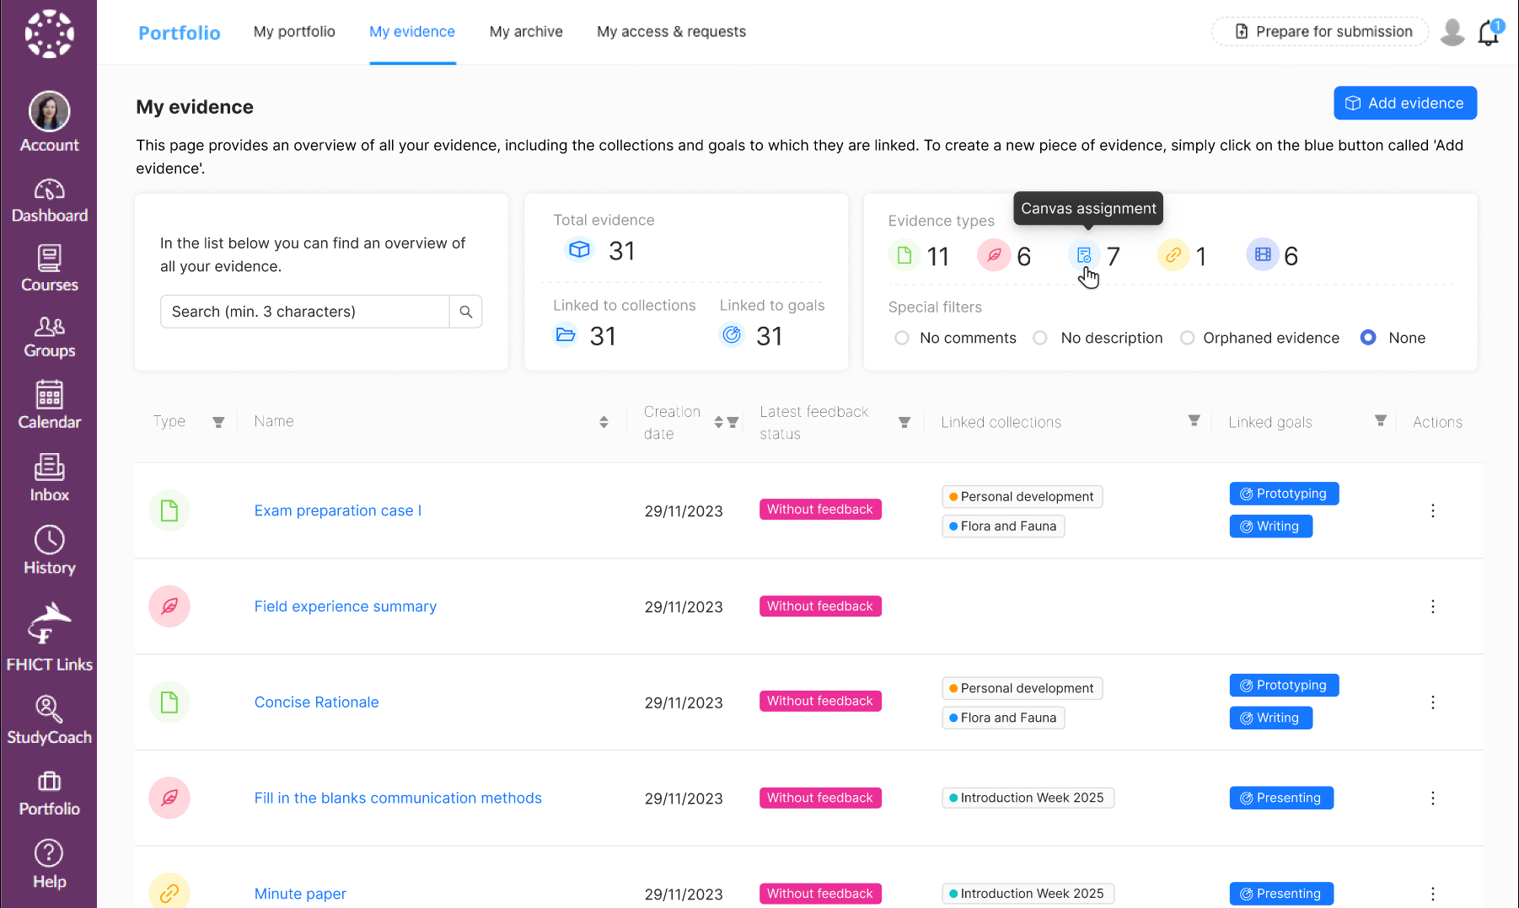

Slide 14
Benefit
Better overview
More control
Tools to find specific evidence
Goals per evidence
Manage collections
Consistent design

Slide 15



The Approach
Research & Analysis
Context
Stakeholders
Requirements
Testing & Feedback
Reviewing
User testing
Improvements
Design
Sketching
Wireframes
Review
Development
Refinement
Implementation
Peer programing
Notes:
Agile – Scrum
Full involvement in team activities
Design Thinking and Double Diamond applied to Design phase
Frequent feedback

Slide 16


The Approach
Research & Analysis
Context
Stakeholders
Requirements
Notes:
Agile – Scrum
Full involvement in team activities
Design Thinking and Double Diamond applied to Design phase
Frequent feedback

Slide 17
The Approach
Research & Analysis
Context
Stakeholders
Requirements
Testing & Feedback
Reviewing
User testing
Improvements
Design
Sketching
Wireframes
Review
Development
Refinement
Implementation
Peer programing
Notes:
Agile – Scrum
Full involvement in team activities
Design Thinking and Double Diamond applied to Design phase
Frequent feedback

Slide 18
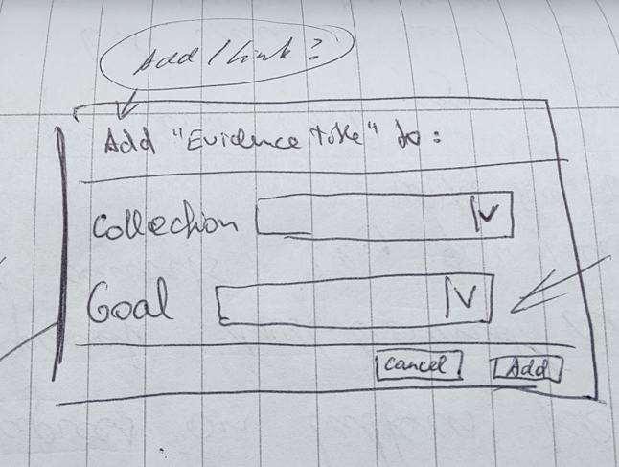
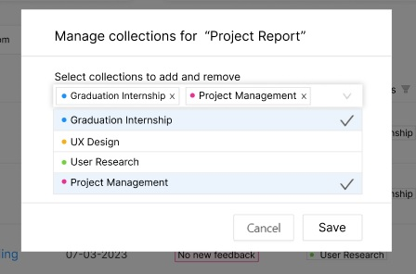
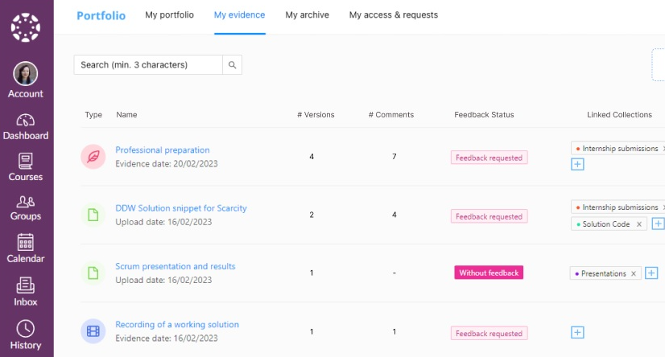
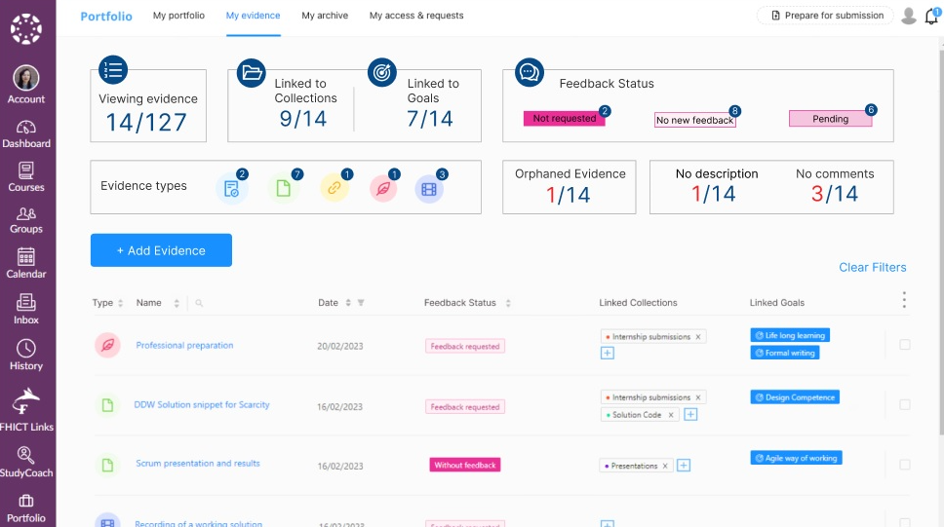
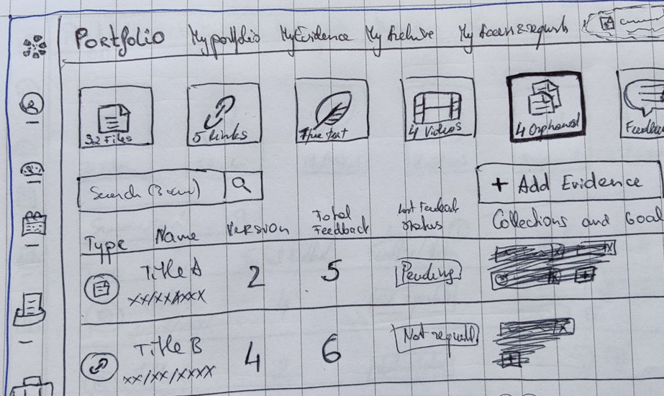
The Approach
Design
Sketching
Wireframes
Review
Notes:
Agile – Scrum
Full involvement in team activities
Design Thinking and Double Diamond applied to Design phase
Frequent feedback

Slide 19
The Approach
Research & Analysis
Context
Stakeholders
Requirements
Testing & Feedback
Reviewing
User testing
Improvements
Design
Sketching
Wireframes
Review
Development
Refinement
Implementation
Peer programing
Notes:
Agile – Scrum
Full involvement in team activities
Design Thinking and Double Diamond applied to Design phase
Frequent feedback

Slide 20
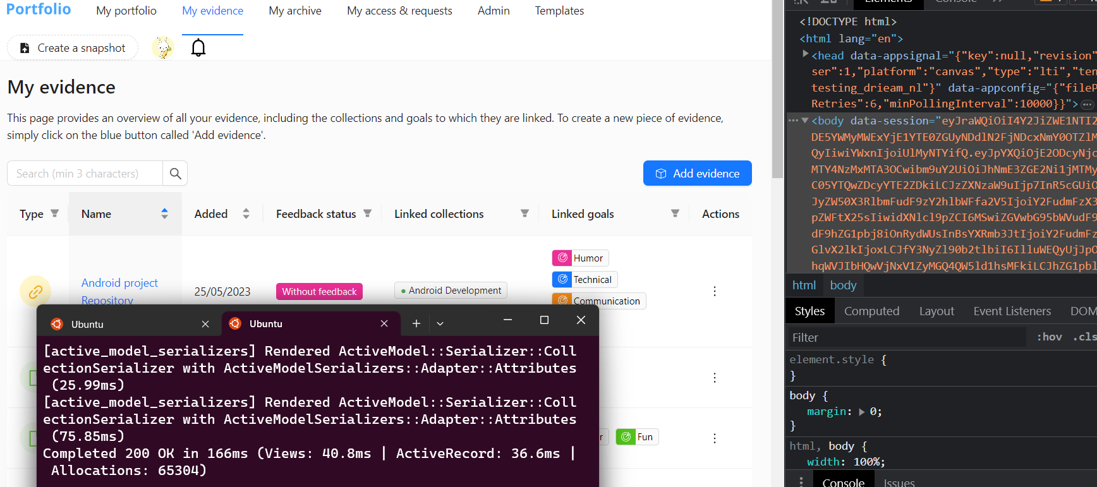

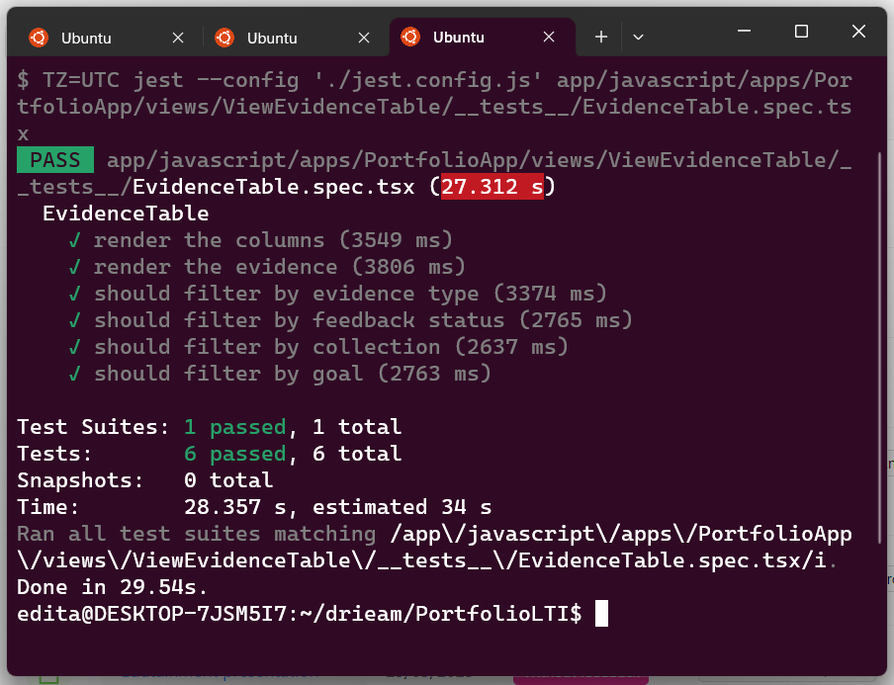
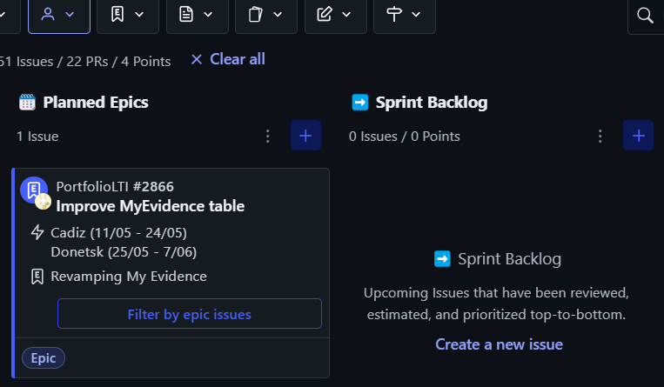
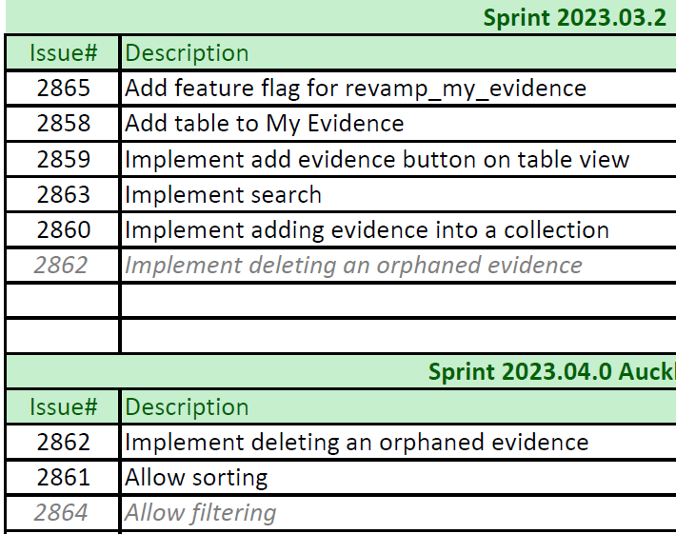
The Approach
Development
Refinement
Implementation
Peer programing
Notes:
Focus on table because of core functionality and THE Dealbreaker

Slide 21
The Approach
Research & Analysis
Context
Stakeholders
Requirements
Testing & Feedback
Reviewing
User testing
Improvements
Design
Sketching
Wireframes
Review
Development
Refinement
Implementation
Peer programing
Notes:
Agile – Scrum
Full involvement in team activities
Design Thinking and Double Diamond applied to Design phase
Frequent feedback

Slide 22

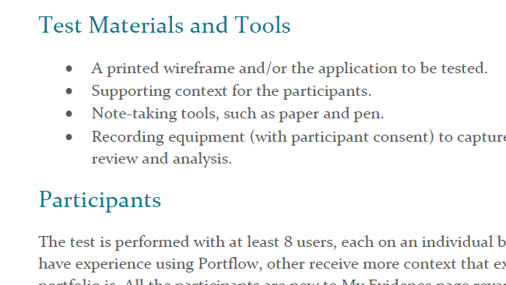
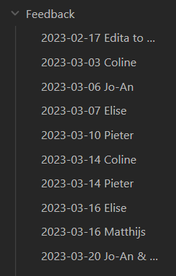
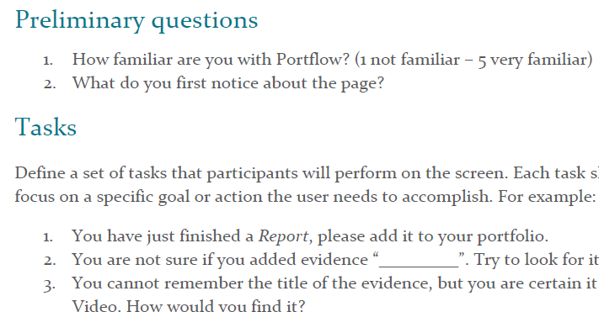
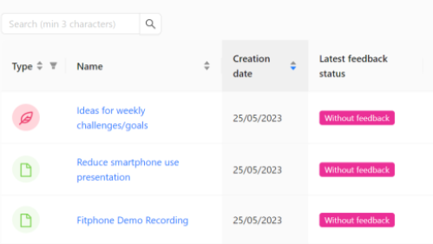
The Approach
Testing & Feedback
Reviewing
User testing
Improvements
Notes:
Agile – Scrum
Full involvement in team activities
Design Thinking and Double Diamond applied to Design phase
Frequent feedback

Slide 23
The Approach
Research & Analysis
Context
Stakeholders
Requirements
Testing & Feedback
Reviewing
User testing
Improvements
Design
Sketching
Wireframes
Review
Development
Refinement
Implementation
Peer programing
Notes:
Agile – Scrum
Full involvement in team activities
Design Thinking and Double Diamond applied to Design phase
Frequent feedback

Slide 24



User Testing
The Table
“Filters stood out, overall, it seems like a perfect tool for Open Learning Course”
“A better version of the current portfolio”
The Dashboard
“Dashboard helps a lot, seems more alive and nicer to use”
“... linked goals and collections count could help see the discrepancy of orphaned evidence.”
Conversation
“A better way to manage the evidence in My Portfolio”
“Excel – like page, but sorts and filters in a nice way”

Slide 25
Demo
Notes:
show the sorter by name/date
link/remove the evidence from collection
filtering multiple
combine 2 filters
delete the evidence

Slide 26
Research

Slide 27
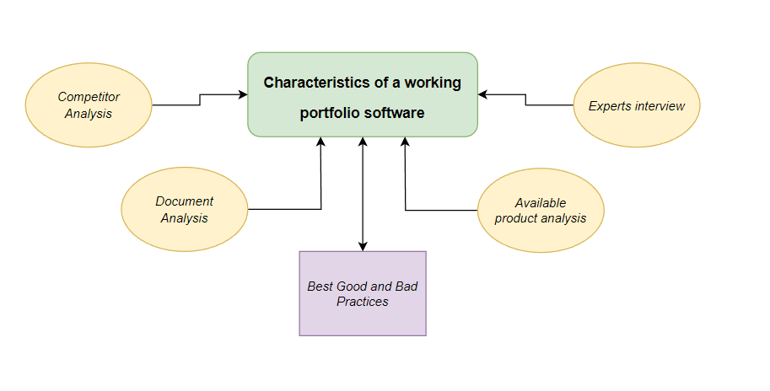

Slide 28
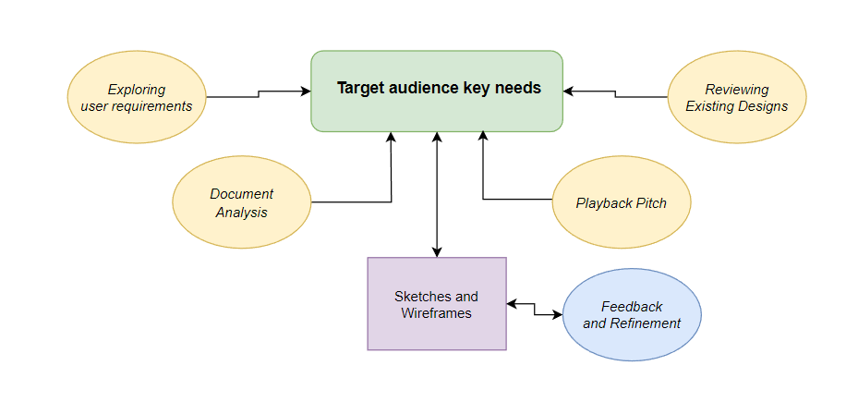

Slide 29
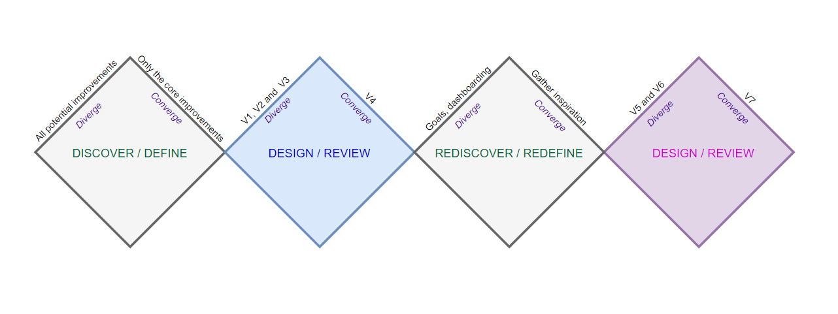

Slide 30
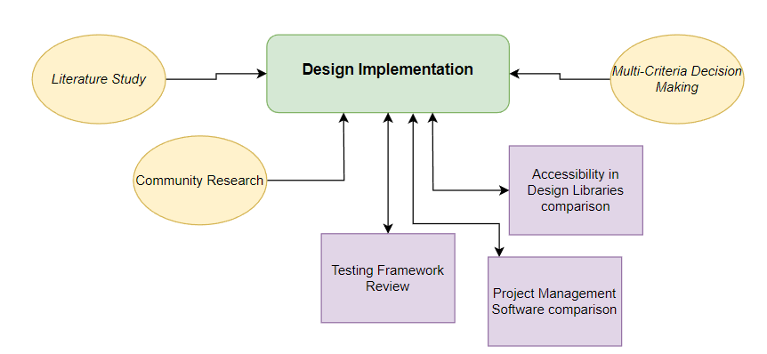

Slide 31
Reflection

Slide 32

Challenges
Independence struggles
Overcoming own barriers
New Frameworks
Learning new tools and excercising new practices
Imposter syndrome
Gaining confidence, setting up boundaries

Slide 33
Personal Growth
Meaningful
Real product for real people, making it better for peers and colleagues
Positive
Healthy working environment, supportive team, encouraging atmosphere
Beneficial
Good for my personal growth, career choice understanding

Slide 34
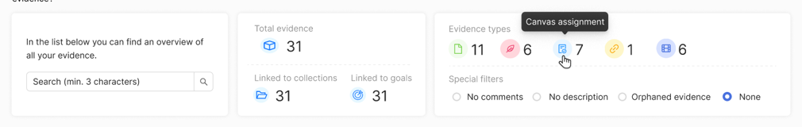
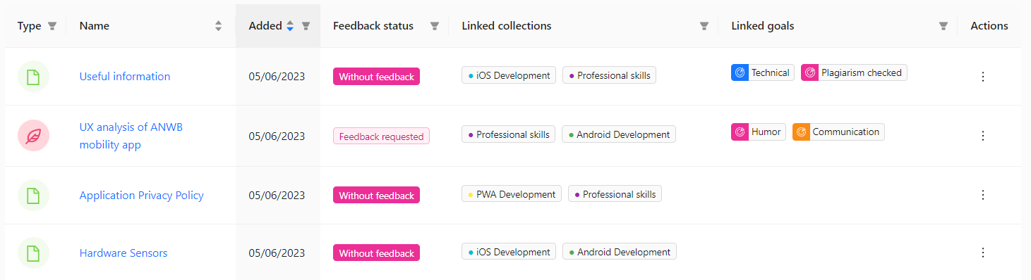
Conclusion
“Making My Evidence tab useful. Giving a reason to actually go to this tab.” – A. Angelov (Fontys student)

Slide 35

Thank you!
Question Time
Question Time

Slide 36


